Slide 1


Computational Intelligence (TC2023)

Slide 2
Unit VI – ML Advanced Questions (1)
Outline
Initial Considerations
Data Quality
Model Quality

Slide 3

Initial Considerations

Slide 4

ML Questions
Security machine learning applications must meet an especially stringent set of requirements before making sense to put them into production.
Systems must have high prediction accuracy requirements because of the unusually high cost of getting something wrong.

Slide 5
Data Quality: Bias

Slide 6



Problem - Bias in Datasets
Well-balanced datasets are scarce and using unbalanced datasets can result in bias that is difficult to detect.
Population
Dataset
Your dataset has more samples of normal e-mails than spam!!!!

Slide 7
Problem - Bias in Datasets
Suppose that a convenient dataset for enterprise X is emails from its corporate email server for the month of March.
Using this dataset eventually produces a classifier that performs very well for enterprise X, but there is no guarantee that it will continue to perform well as time progresses or if brought to another company.
This classifier is a victim of selection bias and exclusion bias because of the temporal and contextual effects that contributed to the selection of the dataset used to train the classifier.

Slide 8
Solutions – What If
To check if your machine learning model is biased or not, you will need to ask many questions and test different scenarios within your data.
For example, you will need to test if your model performance changes if one data point changed, or maybe a different sample of data is used to train or test the model. How do these changes affect the end results of your model?

Slide 9
Solutions – What If
What-If: an open-source interactive tool that makes it easier for programing and no-programing users to test, explore and debug machine learning models.

Slide 10
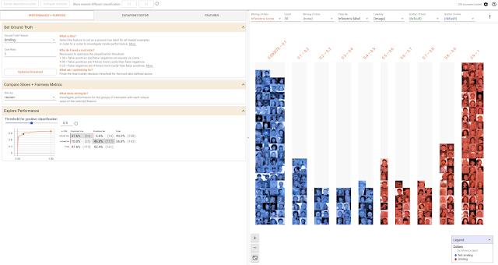
Solutions – What If
What-If: an open-source interactive tool that makes it easier for programing and no-programing users to test, explore and debug machine learning models.

Slide 11
Solutions – What If
What-If gives you the ability to manipulate data points, edit them, generate plots, and specify criteria to evaluate your model, all using a clear and simple GUI.
What-If helps you detect the existence of bias in your machine learning model, but it doesn’t give you a straightforward way to remove that bias.

Slide 12
Solutions – Fair ML
FairML: open-source toolbox that is used to audit machine learning predictive models to detect bias.
FairML was built and developed to answer the question, how much does a specific input affects the performance of a model.
https://github.com/adebayoj/fairml

Slide 13
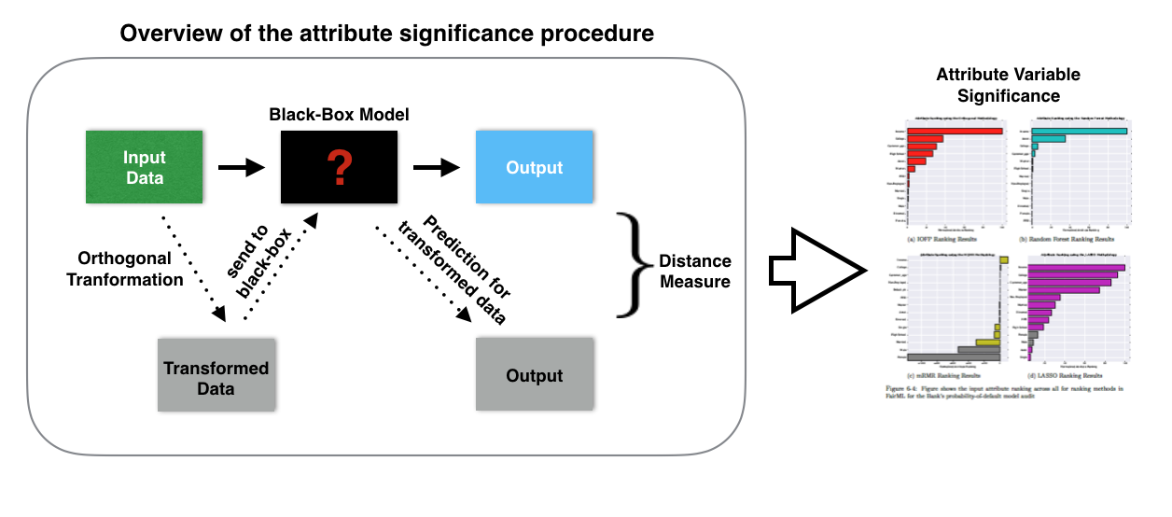
Solutions – Fair ML

Slide 14
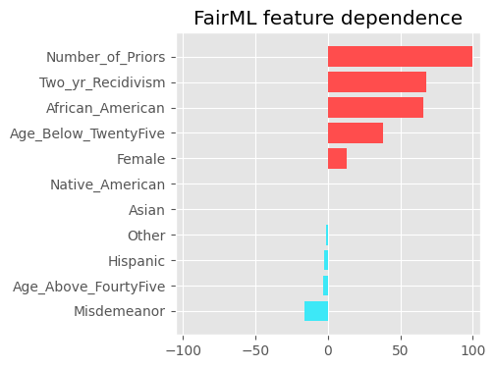
Solutions – Fair ML
bias_detection.py

Slide 15
Data Quality: Label Inaccuracy

Slide 16

Problem – Label Inaccuracy
When doing supervised learning, mislabeled data will cause machine learning algorithms to lose accuracy.
The problem is exacerbated if the validation datasets are also wrongly labeled.
DOG!!!!

Slide 17
Problem – Label Inaccuracy
In some cases, you can avoid data quality issues by carefully defining the scope of the problem.
Inaccurate labels caused by errors in human labeling can be made less likely by involving multiple independent annotators in the labeling process.
You can use statistical measures (such as the Fleiss¹) to assess the reliability of agreement between the annotations of multiple labelers and weed out incorrect labels.
J.L. Fleiss and J. Cohen, “The Equivalence of Weighted Kappa and the Intraclass Correlation Coefficient as Measures of Reliability,” Educational and Psychological Measurement 33 (1973): 613–619.

Slide 18
Problem – Label Inaccuracy
Dataset with noisy labels but it is impossible or too costly to weed out the inaccuracies, increasing regularization parameters to deliberately disincentivize overfitting at the expense of prediction accuracy can be a worthwhile trade-off.
Overfitting a model to a noisily labeled dataset can be catastrophic and result in a “garbage-in, garbage-out” scenario.
Check Feature Engineering Technics – Unit 4 – Network Traffic Analysis (I & II)

Slide 19
Data Quality: Missing Data

Slide 20
Problem: Missing Data
Missing data is one of the most common problems that you will face when working with machine learning.
It is very common for datasets to have rows with missing values.
These can be caused by errors in the data collection process, but datasets can also contain missing data by design.

Slide 21
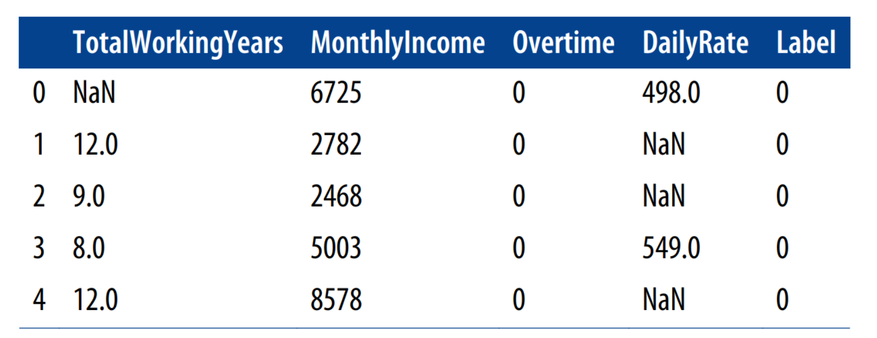
Example: Missing Data
What we are attempting to predict with this dataset is whether an employee has left (or is likely to leave), given the other four features.

Slide 22
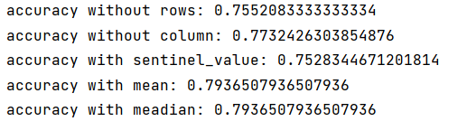
Solution: Missing Data
Discard rows with any missing values (without replacement).
Discard columns that have missing values.
Fill in missing values by collecting more data.
Fill in missing values with zeroes or some other “indicator” value.
Impute the missing values
missing_values_solution.py

Slide 23
Model Quality

Slide 24
Model Quality
Trained models form the core intelligence of machine learning systems.
Without safeguards in place to ensure the quality of these models, the results they produce will be suboptimal.
Model quality is not only important during the initial training and deployment phase. You must also take care as your system and the adversarial activity it faces evolve; regular maintenance and reevaluation will ensure that it does not degrade over time.

Slide 25
Model Quality: Hyperparameter Optimization

Slide 26
Problem: Hyperparameter Optimization
Hyperparameters are machine learning algorithm parameters that are not learned during the regular training process.
Hyperparameters typically need to be chosen before commencing the training phase.
Hyperparameters are a fragile component of machine learning systems because their optimality can be affected by small changes in the input data or other parts of the system.

Slide 27
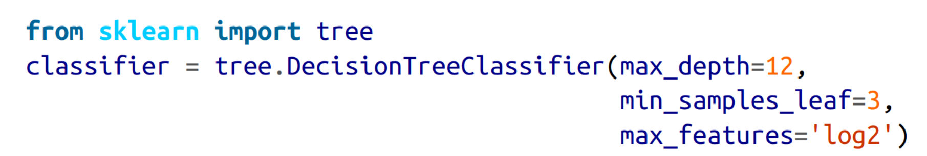
max_depth: tree should grow to 12. If this parameter is not specified, the default behavior of this implementation is to split nodes until all leaves are pure.
min_samples_leaf=3: means that the algorithm should ensure that there are at least three samples in a leaf node.
max_features: is set to log2, which indicates to the classifier that the maximum number of features it should consider when looking for the best split of a node is the base-2 logarithm of the number of features in the data.

Slide 28
Problem: Hyperparameter Optimization
But how do you know what to set the learning rate to?
How many hidden layers in a deep neural network will give the best results?
What value of k to use in k-means clustering?

Slide 29
Grid Search
It is the process of performing hyperparameter tuning in order to determine the optimal values for a given model.
Note that there is no way to know in advance the best values for hyperparameters so ideally, we need to try all possible values to know the optimal values.
GridSearchCV is a function that comes in Scikit, which helps to loop through predefined hyperparameters and fit your estimator (model) on your training set (brute force).

Slide 30
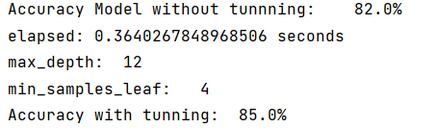
Grid Search
def tunning_decisionTree(X_train, X_test, y_train, y_test): from sklearn.tree import DecisionTreeClassifier from sklearn import metrics dt_classifier = DecisionTreeClassifier() dt_classifier.fit(X_train, y_train) y_pred = dt_classifier.predict(X_test) print('Accuracy Model without tunnning:\t{:.1%}'.format(metrics.accuracy_score(y_test, y_pred))) hyperparam_grid = {'max_depth': [4,6,12], 'min_samples_leaf': [5,4,12]} dt_classifier = DecisionTreeClassifier() classifier = GridSearchCV(dt_classifier, hyperparam_grid) start = time() classifier.fit(X_train, y_train) elapsed = time() - start print('elapsed: {} seconds'.format(elapsed)) print('max_depth:\t{}'.format(classifier.best_estimator_.max_depth)) print('min_samples_leaf:\t{}'.format(classifier.best_estimator_.min_samples_leaf)) y_pred = classifier.predict(X_test) print('Accuracy with tunning:\t{:.1%}'.format(metrics.accuracy_score(y_test, y_pred)))
hyperparameter_tuning.py

Slide 31
How to Tune Deep Learning Params?
Batch size: number of patterns shown to the network before the weights are updated.
Number of epochs: number of times that the entire training dataset is shown to the network during training.

Slide 32
def tunning_deep_learning(X_train, y_train): # create model model = KerasClassifier(build_fn=create_model, verbose=0) # define the grid search parameters batch_size = [10, 20, 40, 60, 80, 100] epochs = [10, 50, 100] param_grid = dict(batch_size=batch_size, epochs=epochs) grid = GridSearchCV(estimator=model, param_grid=param_grid) grid_result = grid.fit(X_train, y_train) # summarize results print("Best: %f using %s" % (grid_result.best_score_, grid_result.best_params_)) means = grid_result.cv_results_['mean_test_score'] stds = grid_result.cv_results_['std_test_score'] params = grid_result.cv_results_['params'] for mean, stdev, param in zip(means, stds, params): print("%f (%f) with: %r" % (mean, stdev, param))

Slide 33
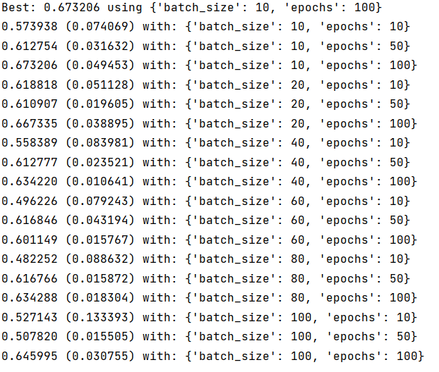

Slide 34
How to Tune Deep Learning Params?
Improve your skills
https://machinelearningmastery.com/grid-search-hyperparameters-deep-learning-models-python-keras/

Slide 35

Hyperparameter Optimization Questions
Even for algorithms that have only a few hyperparameters, grid search is a very time and resource-intensive way to solve the problem because of combinatorial explosion.

Slide 36
Hyperparameter Optimization Questions
Taking this naive approach as a performance baseline, we now consider some ways to optimize this process:
Understand the algorithm and its parameters well
Mimic similar models: research previous similar work in the area.
Remember the dataset has influence in the result.
Don’t start tuning parameters too early

Slide 37
Model Quality: Feature: Feedback Loops, A/B Testing of Models

Slide 38
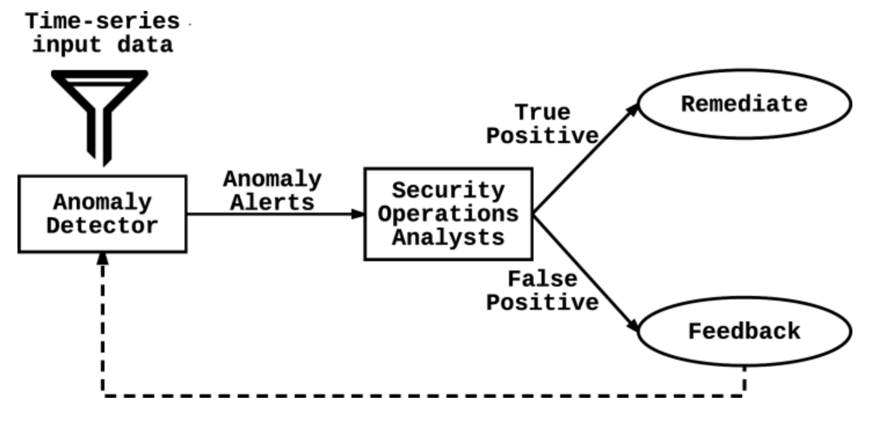
Feedback Loops
Because security machine learning systems have such a low tolerance for inaccuracies, every bit of user feedback needs to be considered to improve system efficacy as much as possible.
For example, an anomaly detection system that raises too many false positive alerts to security operations personnel should take advantage of the correct labels given by human experts during the alert triaging phase to retrain and improve the model.

Slide 39
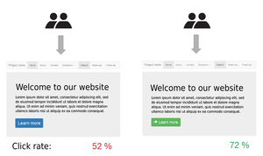
A/B Testing of Models
A/B testing, also known as split testing, refers to a randomized controlled experiment designed to understand how system variants affect metrics.

Slide 40
A/B Testing of Models
The standard procedure for an A/B test is to randomly divide the user population into two groups (A and B) and show each group a different variant of the system in question (e.g., a spam classifier).
Evaluating the experiment consists of collecting data on the metric to be tested from each group and running a statistical test (usually a t-test or chi-squared test) to determine if the metric’s difference between the two groups is statistically significant.

Slide 41
A/B Testing of Models
A/B testing is critical to machine learning systems because evolutionary updates to long-running models (e.g., retraining) might not give you the best results that you can get.
Being able to experiment with new models and determine empirically which gives the best performance gives machine learning systems the flexibility required to adapt to the changing landscape of data and algorithms.
However, you must be careful when running A/B tests in adversarial environments.

Slide 42
Model Quality: Feature: Repeatable and Explainable Results

Slide 43
Feature: Repeatable and Explainable Results
Machine learning systems are frequently evaluated with a single metric: prediction accuracy.
However, there are often more important factors in production environments that contribute to the success and adoption of a machine learning system, especially in the realm of security.

Slide 44
Feature: Repeatable and Explainable Results
There are situations that users disagree with the prediction.
Beyond contributing to the trust between human and machine, an arguably more important effect of repeatable and explainable results is that system maintainers and machine learning engineers will be able to dissect, evaluate, and debug such systems.
Without system introspection, improving such systems would be a very difficult task.

Slide 45
Repeatable
Assuming constantly changing priors in a statistical system (due to continuous adaptation, manual evolution, etc.), we should be able to reproduce any decision made by the system at any reasonable point in its history.
You can achieve this by regularly checkpointing system state and saving a description of the model in a restorable location.
Another way of reproducing results is to log the model parameters with every decision made by the system.

Slide 46
Explainability
It is a complicated concept.
“the goal of Explainable AI (XAI) is to create a suite of new or modified machine learning techniques that produce explainable models that, when combined with effective explanation techniques, enable end users to understand, appropriately trust, and effectively manage the emerging generation of AI systems.”
In essence, a system is explainable if it presents enough decision-making information to allow the user to derive an explanation for the decision.

Slide 47
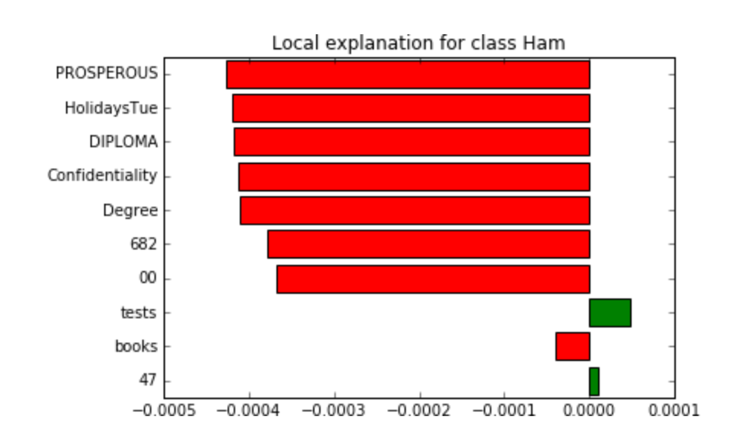
Explainability

Slide 48
Model Quality: Performance

Slide 49
Performance
Machine learning, especially on large datasets, is a computationally intensive task.
Main Goal: Low Latency, High Scalability

Slide 50
Profiling and framework optimization
Software profiling: method of dynamically analyzing the performance of a program.
Profiler: tool used to instrument the software.
The profiler typically inserts hooks into components, functions, events, code, or instructions being executed, and does a deep analysis of the time it takes for each individual component to run.

Slide 51
Algorithm Optimization
Having fewer features means having to do fewer arithmetic operations, which can improve performance. Applying dimensionality reduction methods to remove useless features from your dataset can improve performance.

Slide 52
Algorithm Optimization
Tree-based models (e.g., decision trees, random forests) tend to have very good prediction performance because every query interacts only with a small portion of the model space (one root-to-leaf path per tree). Depending on architecture and hyperparameter choices, neural network predictions can sometimes be speedier than random forests.

Slide 53
Algorithm Optimization
Linear models are fast to train and evaluate. Training of linear models can be parallelized, which allows the training of large linear models to scale very well.
SVMs suffer from widely known scalability problems. They are one of the slower model families to train and are also very memory intensive. It is possible (but complicated) to parallelize SVM training.

Slide 54
Algorithm Optimization
Deep learning algorithms (deep neural nets) are slow to train and quite resource intensive (typically at least millions of matrix multiplications involved) but can easily be parallelized with the appropriate hardware—e.g., graphics processing units (GPUs)—and modern frameworks such as Tensor‐Flow, Torch, or Caffe.

Slide 55
Algorithm Optimization
Approximate nearest neighbor search can significantly speed up close-proximity searches in large datasets. In addition, they are generally very fast to train and have very fast average performance with bounded error.

Slide 56
Computational Intelligence (TC2023)

